Slide 1
Discrete Mathematical Structures
Methods of Proof （证明的方法）

Slide 2
Outline
Form of theorems
Proof Methods for Implications
Proof Methods for Existence
Proof Methods for Unique Existence
Proof Methods for Nonexistence
Proof Methods for Universally Quantified Assertions
Some Fallacies

Slide 3
Methods of Proof
Definition: A theorem(定理) is a valid (正确) logical assertion which can be proved using
other theorems
axioms (公理) (statements which are given to be true) and
rules of inference (推理规则) (logical rules which allow the deduction of conclusions from premises).
A lemma (引理) is a 'pre-theorem' or a result which is needed to prove a theorem.
A corollary (推论)is a 'post-theorem' or a result which follows directly from a theorem.

Slide 4
Form of theorems
Implication
P → Q
Existence or nonexistence
∃xP(x), ¬∃xP(x)
Uniqueness
∃!xP(x)
Universally Quantified Assertions
∀xP(x), ¬∀xP(x)

Slide 5
Methods of Proof
We wish to establish the truth of the 'theorem'
P → Q.
P may be a conjunction of other hypotheses.
P → Q is a conjecture (推测) until a proof is produced.

Slide 6
Proof Methods for Implications
For proving implications p→q, we have:
Direct proof: Assume p is true, and prove q.
Indirect proof: Assume ¬q, and prove ¬p.
Vacuous proof: Prove ¬p by itself.
Trivial proof: Prove q by itself.
Proof by cases: Show p↔(a ∨ b), and (a→q) and (b→q).

Slide 7
Direct proof
assumes the hypotheses are true
uses the rules of inference, axioms and any logical equivalences to establish the truth of the conclusion.

Slide 8
Example
Theorem:
If 6x + 9y = 101, then x or y is not an integer.
Proof: (Direct)
Assume 6x + 9y = 101 is true.
Then from the rules of algebra 3(2x + 3y) = 101.
But 101/3 is not an integer so it must be the case that one of 2x or 3y is not an integer (maybe both).
Therefore, one of x or y must not be an integer.
Q.E.D.

Slide 9
Indirect proof
A direct proof of the contrapositive（逆反式）
assumes the conclusion of P → Q is false (¬ Q is true)
uses the rules of inference, axioms and any logical equivalences to establish the premise P is false.
Note, in order to show that a conjunction of hypotheses is false is suffices to show just one of the hypotheses is false.
P₁∧P₂∧…∧P_{k}→Q ⇔ ¬(P₁∧P₂∧…∧P_{k} ∧¬Q)

Slide 10
Example
A perfect number is one which is the sum of all its divisors except itself.
For example, 6 is perfect since 1 + 2 + 3 = 6. So is 28.
Theorem:
A perfect number is not a prime.
Proof: (Indirect).
We assume the number p is a prime and show it is not perfect.
But the only divisors of a prime are 1 and itself.
Hence the sum of the divisors less than p is 1 which is not equal to p.
Hence p cannot be perfect.
Q.E.D.

Slide 11
Trivial proof (平凡证明)
If we know Q is true then P → Q is true.
If it's raining today then the void set is a subset of every set.
The assertion is trivially true independent of the truth of P.

Slide 12
Trivial Proof Example
Theorem: (For integers n) If n is the sum of two prime numbers, then either n is odd or n is even.
Proof: Any integer n is either odd or even. So the conclusion of the implication is true regardless of the truth of the antecedent. Thus the implication is true trivially.

Slide 13
Vacuous proof (空证明)
If we know one of the hypotheses in P is false then
P → Q is vacuously true.
If I am both rich and poor then hurricane Fran was a mild breeze.
This is of the form
(P ∧ ¬ P) → Q
and the hypotheses form a contradiction.
Hence Q follows from the hypotheses vacuously.

Slide 14
Vacuous Proof Example
Theorem: (For all n) If n is both odd and even, then n² = n + n.
Proof: The statement “n is both odd and even” is necessarily false, since no number can be both odd and even. So, the theorem is vacuously true.

Slide 15
Proof by contradiction(矛盾)
to prove that a statement Q is true
assumes the conclusion Q is false
derives a contradiction, usually of the form P ∧ ¬ P which establishes ¬ Q → 0.
The Contrapositive of this assertion is
1 → Q
from which it follows that Q must be true.
Contrast: The contrapositive proof:
To proof P→ Q, construct and proof ¬Q→ ¬ P.

Slide 16
Example
Theorem: There is no largest prime number.
We assume the conclusion 'there is no largest prime number' is false.
There is a largest prime number. Call it p.
Hence, the set of all primes lie between 1 and p.
Form the product of these primes:
r = 2•3•5•7•11•....•p.
But r + 1 is a prime larger than p. (Why?).
This contradicts the assumption that there is a largest prime.
Q.E.D.

Slide 17
Proof by contradiction
Example: Prove that if you pick 22 days from the calendar, at least 4 must fall on the same day of the week.
Solution:
Assume that no more than 3 of the 22 days fall on the same day of the week.
Because there are 7 days of the week, we could only have picked 21 days.
This contradicts the assumption that we have picked 22 days. Q.E.D.

Slide 18
Proof by Cases
Break the premise of P → Q into an equivalent disjunction of the form
P₁ ∨ P₂∨...∨P_{n} .
Then use the tautology
[(P₁ → Q) ∧(P₂ → Q) ∧...∧ (P_{n} → Q)]⇔ [(P₁ ∨ P₂ ∨... ∨ P_{n} ) → Q]
Each of the implications P_{i} → Q is a case.
You must
Convince the reader that the cases are inclusive, i.e., they exhaust all possibilities
establish all implications

Slide 19
Example
Let ⊗ be the operation 'max' on the set of integers:
if a ≥ b then a⊗b = max{a, b} = a = b⊗a.
Theorem:
The operation ⊗ is associative.
For all a, b, c
(a⊗b)⊗c = a⊗(b⊗c).

Slide 20
Example - Proof:
Let a, b, c be arbitrary integers.
Then one of the following 6 cases must hold (are exhaustive):
1. a ≥ b ≥ c
2. a ≥ c ≥ b
3. b ≥ a ≥ c
4. b ≥ c ≥ a
5. c ≥ a ≥ b
6. c ≥ b ≥ a
Case 1: a⊗b = a, a⊗c = a, and b⊗c = b.
Hence (a⊗b)⊗c = a = a⊗(b⊗c).
Therefore the equality holds for the first case. …

Slide 21
Proof by Cases Example
Theorem: ∀n∈Z ¬(2|n ∨ 3|n) → 24|(n²−1)
Proof: Since 2·3=6, the value of n mod 6 is sufficient to tell us whether 2|n or 3|n. If (n mod 6)∈{0,3} then 3|n; if it is in {0,2,4} then 2|n. Thus (n mod 6)∈{1,5}.
Case #1: If n mod 6 = 1, then (∃k) n=6k+1. n²=36k²+12k+1, so n²−1=36k²+12k = 12(3k+1)k. Note 2|(3k+1)k since either k or 3k+1 is even. Thus 24|(n²−1).
Case #2: If n mod 6 = 5, then n=6k+5. n²−1 = (n−1)·(n+1) = (6k+4)·(6k+6) = 12·(3k+2)·(k+1). Either k+1 or 3k+2 is even. Thus, 24|(n²−1).

Slide 22
Exhaustive Proof
Example 2
Prove that the only consecutive positive integers not exceeding 100 that are perfect powers are 8 and 9.
An integer is a perfect power if it equals nª, where a is an integer greater than 1.)

Slide 23
Solution
We use a proof by exhaustion.
look at all perfect powers not exceeding 100 and checking whether the next largest integer is also a perfect power.
The squares of positive integers: 1, 4, 9, 16, 25, 36, 49, 64, 81, and 100.
The cubes of positive integers: 1, 8, 27, and 64.
The fourth powers of positive integers: 1, 16, and 81.
The fifth powers of positive integers : 1 and 32.
The sixth powers of positive integers: 1 and 64.
There are no powers of positive integers higher than the sixth power not exceeding 100, other than 1.
Looking at this list of perfect powers not exceeding 100, we see that n = 8 is the only perfect power n for which n + 1 is also a perfect power. That is, 2³ = 8 and 3² = 9 are the only two consecutive perfect powers not exceeding 100.

Slide 24
Proof by Examples?
A universal statement can never be proven by using examples, unless the universe can be validly reduced to only finitely many examples, and your proof covers all of them!
Theorem: ¬∃x,y∈Z: x²+3y² = 8.
Proof:
If |x|≥3 or |y|≥2 then x²+3y² >8.
This leaves x²∈{0,1,4} and 3y²∈{0,3}.
The largest pair sum to 4+3 = 7 < 8.

Slide 25
Without Loss of generality
Example 7
Show that if x and y are integers and both xy and x + y are even, then both x and y are even.
proof by contraposition, the notion of without loss of generality, and proof by cases.
suppose that x and y are not both even. That is, assume that x is odd or that y is odd (or both).
Without loss of generality, we assume that x is odd, so that
x = 2m + 1 for some integer m.
To complete the proof, to show that xy is odd or x + y is odd.

Slide 26
Case 1: y is even.
y = 2n for some integer n
x + y = (2m + 1) + 2n = 2(m + n) + 1 is odd.
Case 2: y is odd.
y = 2n + 1 for some integer n
x ∙ y = (2m + 1) (2n + 1) = 2(2m ∙ n +m + n) + 1 is odd.
We only cover the case where x is odd because the case where y is odd is similar. The use phrase without loss of generality (WLOG) indicates this.

Slide 27
Common errors
Example 9 What is wrong with this “proof?”
“Theorem:” If x is a real number, then x² is a positive real number.
“Proof:" Let p1 be “x is positive,” let p2 be “x is negative,” and let q be “x² is positive.”
To show that p1 → q is true, note that when x is positive, x² is positive because it is the product of two positive numbers, x and x.
To show that p2 → q, note that when x is negative, x² is positive because it is the product of two negative numbers, x and x.
This completes the proof.
Solution:
The problem with this “proof” is that we missed the case of x = 0. When x = 0, x² = 0 is not positive, so the supposed theorem is false.
If p is “x is a real number,” then we can prove results where p is the hypothesis with three cases, p1, p2, and p3, where p1 is “x is positive,” p2 is “x is negative,” and p3 is “x = 0” because of the equivalence p ↔ p1 ∨ p2 ∨ p3.

Slide 28
Proof Methods for Existence
We wish to establish the truth of
∃xP(x).
Constructive existence proof:
Establish P(c) is true for some c in the universe.
Then ∃xP(x) is true by Existential Generalization (EG).

Slide 29
Existence Proofs
Theorem:
There exists an integer solution to the equation
x² + y² = z².
Proof:
Choose x = 3, y = 4, z = 5.

Slide 30
A Constructive Existence Proof
Example 10: Show that there is a positive integer that can be written as the sum of cubes of positive integers in two different ways:
Proof:
1729 = 10³ + 9³ = 12³ + 1³

Slide 31
A Constructive Existence Proof
Theorem: For any integer n>0, there exists a sequence of n consecutive composite integers.
Same statement in predicate logic: ∀n>0 ∃x ∀i (1≤i≤n)→(x+i is composite)
Proof follows on next slide…

Slide 32
The proof...
Given n>0, let x = (n + 1)! + 1.
Let i ≥ 1 and i ≤ n, and consider x+i.
Note x+i = (n + 1)! + (i + 1).
Note (i+1)|(n+1)!, since 2 ≤ i+1 ≤ n+1.
Also (i+1)|(i+1). So, (i+1)|(x+i).
∴ x+i is composite.
∴ ∀n ∃x ∀1≤i≤n : x+i is composite. Q.E.D.
Notes:
Need number theory for this example. At least, need the definitions of factorial “!”, and divides notation “|”.

Slide 33
Nonconstructive existence proof
Assume no c exists which makes P(c) true and derive a contradiction.

Slide 34
Nonconstructive Existence Proof
Theorem: There are infinitely many prime numbers.
Any finite set of numbers must contain a maximal element, so we can prove the theorem if we can just show that there is no largest prime number.
I.e., show that for any prime number, there is a larger number that is also prime.
More generally: For any number, ∃ a larger prime.
Formally: Show ∀n ∃p>n : p is prime.

Slide 35
The proof, using proof by cases...
Given n>0, prove there is a prime p>n.
Consider x = n!+1. Since x>1, we know that (x is prime)∨(x is composite).
Case 1: Suppose x is prime. Obviously x>n, so let p=x and we’re done.
Case 2: x has a prime factor p. But if p≤n, then x mod p = 1. So p>n, and we’re done.

Slide 36
Nonconstructive Existence Proof
Example 11: Show that there exist irrational numbers x and y such that x^{y} is rational.
Proof:
We know that irrational.
Consider the number .
If it is rational, x = and y =
If it is irrational, x = and y = ,
x^{y} =

Slide 37
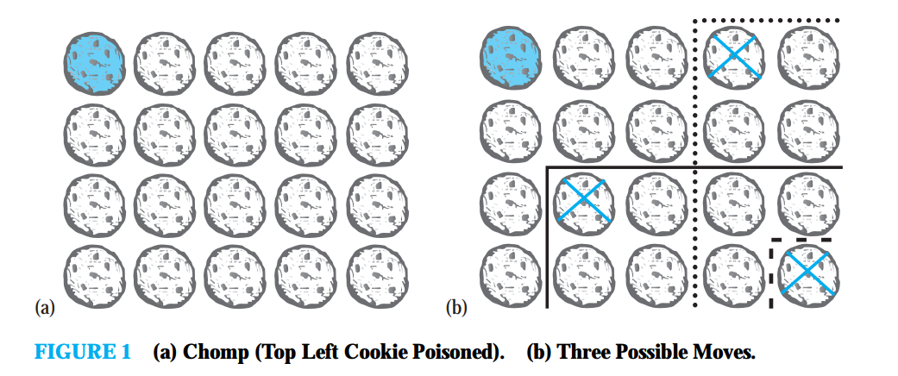
EXAMPLE 12 Chomp is a game played by two players.
In this game, cookies are laid out on a rectangular grid. The cookie in the top left position is poisoned.
The two players take turns making moves; at each move, a player is required to eat a remaining cookie, together with all cookies to the right and/or below it.
The loser is the player who has no choice but to eat the poisoned cookie.
We ask whether one of the two players has a winning strategy. That is, can one of the players always make moves that are guaranteed to lead to a win?

Slide 38
Solution
We will give a nonconstructive existence proof of a winning strategy for the first player.(That is, we will show that the first player always has a winning strategy without explicitly describing the moves this player must follow)
First, note that the game ends and cannot finish in a draw because with each move at least one cookie is eaten, so after no more than m × n moves the game ends, where the initial grid is m × n.

Slide 39
Solution
Now, suppose that the first player begins the game by eating just the cookie in the bottom right corner. There are two possibilities
this is the first move of a winning strategy for the first player
or the second player can make a move that is the first move of a winning strategy for the second player.
In this second case, instead of eating just the cookie in the bottom right corner, the first player could have made the same move that the second player made as the first move of a winning strategy (and then continued to follow that winning strategy). This would guarantee a win for the first player

Slide 40

Proof Methods for Uniqueness
$$∃x(P(x)∧∀y(P(y)→y=x))$$
Example13: Show that if a and b are real numbers and a ≠0, then there is a unique real number r such that ar + b = 0.
Solution:
Existence:
The real number r = −b/a is a solution of ar + b = 0
because a(−b/a) + b = −b + b =0.
Uniqueness:
Suppose that s is a real number such that as + b = 0.
Then ar + b = as + b, where r = −b/a.
Subtracting b from both sides and dividing by a shows that
r = s.

Slide 41
Disproof by Counterexample (反例)
Recall that ∃x ¬ P(x)⇔ ¬ ∀xP(x ).
To establish that ¬ ∀xP(x ) is true (or ∀xP(x) is false) construct a c such that ¬ P(c) is true or P(c) is false.
In this case c is called a counterexample to the assertion ∀xP(x)

Slide 42
Nonexistence Proofs
We wish to establish the truth of
¬ ∃xP( x) (which is equivalent to ∀x ¬ P(x)).
Use a proof by contradiction by assuming there is a c which makes P(c) true.

Slide 43
Universally Quantified Assertions
We wish to establish the truth of
∀xP(x).
We assume that x is an arbitrary member of the universe and show P(x) must be true. Using UG it follows that ∀xP(x)

Slide 44
Example
Theorem: For the universe of integers, x is even iff x² is even.
Proof:
The quantified assertion is
∀x[x is even ↔ x² is even]
Assume x is arbitrary.
Recall that P ↔ Q is equivalent to (P → Q) ∧ (Q → P).

Slide 45
Example
Case 1. We show if x is even then x² is even using a direct proof (the only if part or necessity).
If x is even then x = 2k for some integer k.
Hence, x² = 4k² = 2(2k²) which is even since it is an integer which is divisible by 2.
This completes the proof of case 1.

Slide 46
Example
Case 2. We show that if x² is even then x must be even (the if part or sufficiency) .
We use an indirect proof:
Assume x is not even and show x² is not even.
If x is not even then it must be odd.
So, x = 2k + 1 for some k.
Then x² = (2k + 1)² = 4k² + 4k + 1 = 2(2k² + 2k) + 1
which is odd and hence not even.
This completes the proof of the second case.

Slide 47
Example
Therefore we have shown x is even iff x² is even.
Since x was arbitrary, the result follows by UG.
Q.E.D.

Slide 48
Fallacies (谬论) - incorrect inferences
The Fallacy of Affirming the Consequent
If the butler did it he has blood on his hands.
The butler had blood on his hands.
Therefore, the butler did it.
This argument has the form
P → Q
Q
∴P
or
[(P → Q) ∧ Q] → P

Slide 49
The Fallacy of Denying the Antecedent
If the butler is nervous, he did it.
The butler is really mellow.
Therefore, the butler didn't do it.
This argument has the form
P→Q
¬P
∴¬Q
or
[(P → Q) ∧ ¬P] → ¬Q

Slide 50
Mistakes in proofs
Example 16
Example 17
Example 18

Slide 51
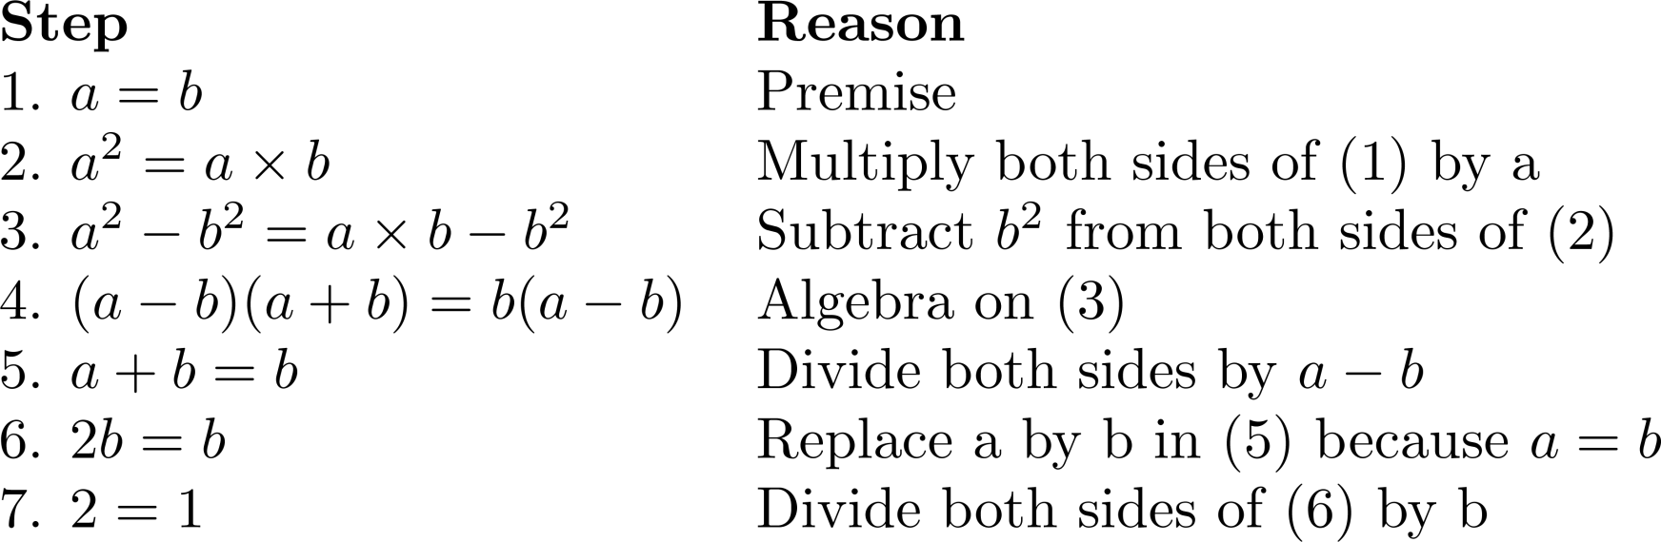
What is wrong with this?
“Proof” that 1 = 2 (Example 16 )
Solution: Step 5. a - b = 0 by the premise and division by 0 is undefined.

Slide 52
What is wrong with this?
EXAMPLE 17 “Theorem:” If n² is positive, then n is positive.
“Proof:"
Suppose that n² is positive.
Because the conditional statement “If n is positive, then n² is positive” is true, we can conclude that n is positive.
Solution:
Let P (n) be “n is positive” and Q(n) be “n² is positive.”
Then our hypothesis is Q(n).
The statement “If n is positive, then n² is positive” is the statement ∀n(P (n) → Q(n)).
From the hypothesis Q(n) and the statement ∀n(P (n) → Q(n)) we cannot conclude P (n), because we are not using a valid rule of inference.
A counterexample : n = −1 for which n² = 1 is positive, but n is negative.

Slide 53
What is wrong with this?
EXAMPLE 18 “Theorem:” If n is not positive, then n² is not positive. (This is the contrapositive of the “theorem” in Example 17.)
“Proof:"
Suppose that n is not positive. Because the conditional statement “If n is positive, then n² is positive” is true, we can conclude that n² is not positive.
Solution:
Let P (n) be “n is positive” and Q(n) be “n² is positive.”
our hypothesis is ¬P (n)
the statement “If n is positive, then n² is positive” is the statement ∀n(P(n)→Q(n)).
From the hypothesis ¬P (n) and the statement ∀n(P (n) → Q(n)) we cannot conclude ¬Q(n),because we are not using a valid rule of inference.
A counterexample : n = −1 for which n² = 1 is positive.

Slide 54
Circular Reasoning
The fallacy of (explicitly or implicitly) assuming the very statement you are trying to prove in the course of its proof. Example:
Prove that an integer n is even, if n² is even.
Attempted proof: “Assume n² is even. Then n²=2k for some integer k. Dividing both sides by n gives n = (2k)/n = 2(k/n). So there is an integer j (namely k/n) such that n=2j. Therefore n is even.”
Circular reasoning is used in this proof. Where?
Begs the question: How do you show that j=k/n=n/2 is an integer, without first assuming that n is even?
Notes:
The given statement is implicitly universal: FORALL integers n, n is even if n-squared is even.
Note that although the statement we are trying to prove is true, our proof of it is invalid. It does not give a clear, valid path to the conclusion.

Slide 55
A Correct Proof
We know that n must be either odd or even.
If n were odd, then n² would be odd, since an odd number times an odd number is always an odd number.
Since n² is even, it is not odd, since no even number is also an odd number.
Thus, by modus tollens, n is not odd either.
Thus, by disjunctive syllogism, n must be even. ■
This proof is correct, but not quite complete, since we used several lemmas without proving them. Can you identify what they are?

Slide 56
A More Verbose Version
Uses some number theory we haven’t defined yet.
Suppose n² is even ∴2|n² ∴ n² mod 2 = 0.
Of course n mod 2 is either 0 or 1.
If it’s 1, then n≡1 (mod 2), so n²≡1 (mod 2), using the theorem that if a≡b (mod m) and c≡d (mod m) then ac≡bd (mod m), with a=c=n and b=d=1.
Now n²≡1 (mod 2) implies that n² mod 2 = 1.
So by the hypothetical syllogism rule, (n mod 2 = 1) implies (n² mod 2 = 1). Since we know n² mod 2 = 0 ≠ 1, by modus tollens we know that n mod 2 ≠ 1. So by disjunctive syllogism we have that n mod 2 = 0 ∴2|n ∴ n is even.
Notes:
This is a relatively involved example and it should perhaps be saved until after some easier ones have already been done. We also need number theory first for this example. The vertical bar “|” means “divides (evenly).” mod refers to the remainder of a division. Later in the class we will encounter the theorem mentioned (first red-highlighted statement). The triple horizontal lines mean between two numbers means those numbers are “congruent” under the given modulus, that is, they give the same remainder when divided by the modulus.

Slide 57
Dear students
Learning how to construct proofs is probably one of the most difficult things you will face in life. Few of us are gifted enough to do it with ease. One only learns how to do it by practicing.

Slide 58
Proof strategy Overview
we already saw:
Several types of proofs of implications p→q:
Vacuous, Trivial, Direct, Indirect，Proof by cases
Types of existence proofs:
Constructive vs. Nonconstructive.
Some methods of proving general statements p:
proof by contradiction.
In this section, we will see examples of:
Forward vs. backward reasoning.
Adapting existing proofs.
Turning conjectures into proofs.

Slide 59
Forward Reasoning
Have premises p, and want to prove q.
Find a s₁ such that p→s₁
Then, modus ponens gives you s₁.
Then, find an s₂ (such that) s₁→s₂.
Then, modus ponens gives you s₂.
And hope to eventually get to an s_{n} , s_{n}→q.
The problem with this method is…
It can be tough to see the path looking from p.

Slide 60
Backward Reasoning
It can often be easier to see the very same path if you just start looking from the conclusion q instead…
That is, first find an s₋₁ such that s₋₁→q.
Then, find an s₋₂ , s₋₂→s₋₁, and so on…
Working back to an s_{−n} , p→s_{−n.}
Note we still are using modus ponens to propagate truth forwards down the chain from p to s_{−n} to … to s ₋₁ to q!
We are finding the chain backwards, but applying it forwards.
This is not quite the same thing as an indirect proof…
In that, we would use modus tollens and ¬q to prove ¬s₋₁, etc.
However, it is similar.

Slide 61
Backward Reasoning Example
Example 14
Theorem: ∀a>0,b>0,a≠b: (a+b)/2 > (ab)^{1/2}.
Proof:
Notice it is not obvious how to go from the premises a>0, b>0, a≠b directly forward to the conclusion (a+b)/2 > (ab)^{1/2}.
So, let’s work backwards from the conclusion, (a+b)/2 > (ab)^{1/2} !

Slide 62
Steps of Example
(a+b)/2 > (ab)^{1/2} ⇔ (squaring both sides)
This preserves the “>” since both sides are positive.
(a+b)²/4 > ab ⇔ (multiplying through by 4)
(a+b)² > 4ab ⇔ (squaring a+b)
a²+2ab+b² > 4ab ⇔ (subtracting out 4ab)
a²−2ab+b² > 0 ⇔ (factoring left side)
(a−b)² > 0
Now, since a≠b, (a−b)≠0, thus (a−b)²>0, and we can work our way back along the chain of steps…

Slide 63
“Forwardized” version of Example
Theorem: ∀a>0,b>0,a≠b: (a+b)/2 > (ab)^{1/2}.
Proof. If Since a≠b, (a−b)≠0. Thus, (a−b)²>0, i.e., a²−2ab+b² > 0. Adding 4ab to both sides, a²+2ab+b² > 4ab. Factoring the left side, we have (a+b)² > 4ab, so (a+b)²/4 > ab. Since ab is positive, we can take the square root of both sides and get (a+b)/2 > (ab)^{1/2}. ■
This is just a simple proof proceeding directly from premises to conclusion, but if you don’t realize how it was obtained, it looks “magical.”
A common student reaction: “But how did you know to pick 4ab out of thin air, to add to both sides?”
Answer: By working backwards from the conclusion!

Slide 64
Stone Game Example
Example 15
Game rules:
There are 15 stones in a pile. Two players take turns removing either 1, 2, or 3 stones. Whoever takes the last stone wins.
Theorem: There is a strategy for the first player that guarantees him a win.
How do we prove this? Constructive proof…
Looks complicated… How do we pick out the winning strategy from among all possible strategies?
Work backwards from the endgame!

Slide 65
Working Backwards in the Game
Player 1 wins if it is player 2’s turn and there are no stones…
P1 can arrange this if it is his turn, and there are 1, 2, or 3 stones…
This will be true as long as player 2 had 4 stones on his turn…
And so on…
Player 1 | Player 2
 | 0
1, 2, 3
 | 4
5, 6, 7
 | 8
9, 10, 11
 | 12
13, 14, 15

Slide 66
“Forwardized” version
Theorem. Whoever moves first can always force a win.
Proof.
Player 1 can remove 3 stones, leaving 12.
After player 2 moves, there will then be either 11, 10, or 9 stones left.
In any of these cases, player 1 can then reduce the number of stones to 8.
Then, player 2 will reduce the number to 7, 6, or 5.
Then, player 1 can reduce the number to 4.
Then, player 2 must reduce them to 3, 2, or 1.
Player 1 then removes the remaining stones and wins.

Slide 67
Adapting Existing Proofs
Example
Theorem: There are infinitely many primes of the form 4k+3, where k∈N.
Recall we proved there are infinitely many primes because if p₁,…,p_{n} were all the primes, then (∏p_{i})+1 must be prime or have a prime factor greater than p_{n}, ⇒ contradiction!
Proof: Similarly, suppose q₁,…,q_{n} lists all primes of the form 4k+3,
and analogously consider Q = 4(∏q_{i})+3.
Unfortunately, since q₁ = 3 is possible, 3|Q and so Q does have a prime factor among the q_{i}, so this doesn’t work!
So instead, consider Q = 4(∏q_{i})−1 = 4(∏q_{i}−1)+3. This has the right form, and has no q_{i} as a factor since ∀i: Q ≡ −1 (mod q_{i}).
Notes:
Hence if N were a product of primes all of which had the form 4k +1, then
Proof: Suppose that p1, p2, . . . , pn are all the primes of the form 4k + 3.
Consider
N = 4p1p2 . . . pn − 1 = 4(p1p2 . . . pn − 1) + 3.
Then N is a product of prime numbers, all of which must be odd. Note that
(4k + 1)(4l + 1) = 4kl + 4k + 4l + 1 = 4(kl + k + l) + 1.
N would also have this form. Therefore one of the prime divisors of N must
have the form 4k + 3, so is pi for some i. Then
pi | (4p1p2 . . . pn − N) = 1,
a contradiction. This completes the proof.

Slide 68
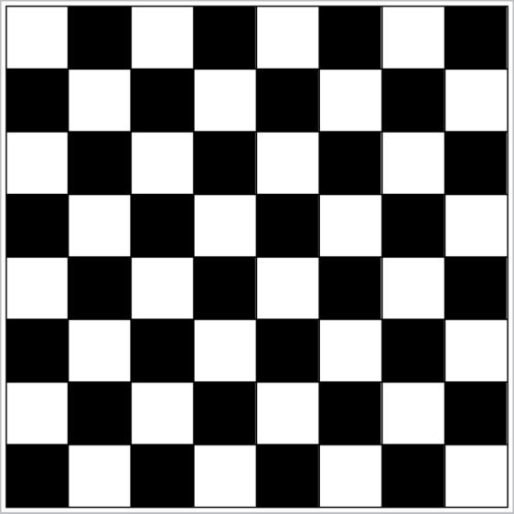
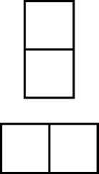
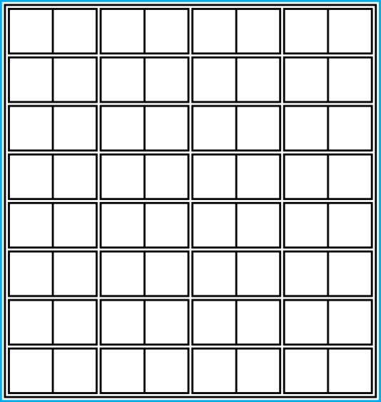
Proof and Disproof: Tilings
Example 1: Can we tile the standard checkerboard using dominos?
Solution: Yes! One example provides a constructive existence proof.
Two Dominoes
The Standard Checkerboard
One Possible Solution

Slide 69
Tilings
Example 2: Can we tile a checkerboard obtained by removing one of the four corner squares of a standard checkerboard?
Solution:
Our checkerboard has 64 − 1 = 63 squares.
Since each domino has two squares, a board with a tiling must have an even number of squares.
The number 63 is not even.
We have a contradiction.

Slide 70
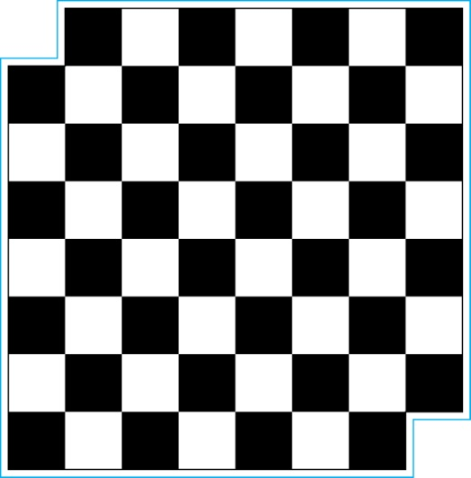
Tilings
Example 3: Can we tile a board obtained by removing both the upper left and the lower right squares of a standard checkerboard?
Dominoes
Nonstandard Checkerboard
Continued on next slide →

Slide 71
Tilings
Solution:
There are 62 squares in this board.
To tile it we need 31 dominos.
Key fact: Each domino covers one black and one white square.
Therefore the tiling covers 31 black squares and 31 white squares.
Our board has either 30 black squares and 32 white squares or 32 black squares and 30 white squares.
Contradiction!

Slide 72
Even Great Mathematicians Can Propose False Conjectures!
Euler conjectured that for n>2, the sum of n−1 n^{th} powers of positive integers is not an nth power.
Remained true for all cases checked for 200 years, but no proof was found.
Finally, in 1966, someone noticed that 27⁵ + 84⁵ + 110⁵ + 133⁵ = 144⁵.
Larger counter-examples have also been found for n=4, but none for n>5 yet.

Slide 73
Fermat’s “Last Theorem”
Theorem 1
Theorem: x^{n}+y^{n}=z^{n} has no solutions in integers xyz ≠ 0 with integer n>2.
In the 1600s, Fermat famously claimed in a marginal note that he had a “wondrous proof” of the theorem.
But unfortunately, if he had one, he never published it!
The theorem remained a publicly unproven conjecture for the next ~400 years!
Finally, a proof that requires hundreds of pages of advanced mathematics was found by Wiles at Princeton in 1990.
It took him 10 years of work to find it!
Challenge: Find a short, simple proof of Fermat’s last theorem, and you will become instantly famous!

Slide 74
Some Open Conjectures
Example 23
Conjecture: (The Hailstone Problem) If h(x) = x/2 when x is even, and 3x+1 when x is odd, then ∀x∈N ∃n∈N h^{n}(x) = 1 (where the superscript denotes composition of h with itself n times).
For example, starting with x = 13:
h(13) = 3∙13 + 1 = 40, h(40) = 40/2 = 20, h(20) = 20/2 = 10,
h(10) = 10/2 = 5, h(5) = 3∙5 + 1 = 16,h(16) = 16/2 = 8,
h(8) = 8/2 = 4, h(4) = 4/2 = 2, h(2) = 2/2 = 1
The conjecture has been verified using computers up to 5.6 ∙ 10¹³ .
Prove any of these, and you can probably have a lifetime career sitting around doing pure mathematics…

Slide 75
Additional Proof Methods
Later we will see many other proof methods:
Mathematical induction, which is a useful method for proving statements of the form ∀n P(n), where the domain consists of all positive integers.
Structural induction, which can be used to prove such results about recursively defined sets.
Cantor diagonalization is used to prove results about the size of infinite sets.
Combinatorial proofs use counting arguments.

Slide 76
Homework
§1.7
8, 20, 30
§1.8
14, 16, 32, 40

